Slide 1
ENGLISH PREMIER LEAGUE IN THE 21ST CENTURY
The key of this research and analysis is to obtain concrete data for premier league teams in the 21st century.
The first stat that I am interested in is which team has the most premier league trophies, so we can see which teams are the most succesfull.
I will also find which team has the most goals scored, and the least goals conceded by teams from the premier league from 2000 to the present day, so I will get the best attacking , and the best defending team in that period.
After analyzing the information found and processing the data, we will get the most successful team in the Premier League in the past 23 years, i.e. in the 21st century.
The following methods, tools and technologies will be used for this complete research, processing, analysis and visual presentation of data:
Web Scraping,
Data preparation,
Data analysis using SQL,
Data analysis and visualization using Tableau.

Slide 2
WORK PROCEDURE
It was necessary to find all the final tables of the Premier League from 2000 to the present day, which I managed, I found a dataset, i.e. a .csv file up to the year 2022, on the website "https://www.kaggle.com", and I added the year 2023 later, with the help of www.wikipedia.com.
After that, I created a premier league database, with the "Standings" table, where I created all the necessary columns to match the .csv file, which is one of the conditions to be able to import the .csv file.
In the standings table we have the following columns:
"ID , Season , Pos, Team, Pld, W, D, L, GF, GA, GD, PTS, Qualification_or_Relegation"
Pos – Position on the table
Pld – Number of matches played
W – Number of wins achieved in the season
D – Number of tied results
L – Number of games lost
GF – Goals scored
GA – Goals conceded
GD – Goal difference
PTS – Points earned during the season
Qualification_or_Relegation – What they qualified for in the season
(e.g. the first 4 go to the Champions League),
and who was relegated from the premier league (the last 3 are relegated)

Slide 3
My goal is to get the data for the number of Premier League winners in the period 2000-2023.
After that, for each winner, we will get the exact number of times each of them won the premier league.
In this way, we will get the information about the most successful Premier League team for the 21st century.
With the extraction of goals scored data, in all seasons for each team, we will get accurate data on which team has the best attack in the last 23 years of the premier league.
Also I will extract the data for the goals conceded by each team in all seasons, so we will get data on which team has the best defense in the last 23 years of premier league.
With ‘Tableau’ , I will see which team has averaged the most points , which team has the most wins , and which teams played the least number of season in the premier league.
At the end of my project I will analyze premier league’s ‘Big Five’ stats, which are widely considered to be the best teams of the premier league : Manchester United, Manchester City, Arsenal, Chelsea, and Liverpool.

Slide 4
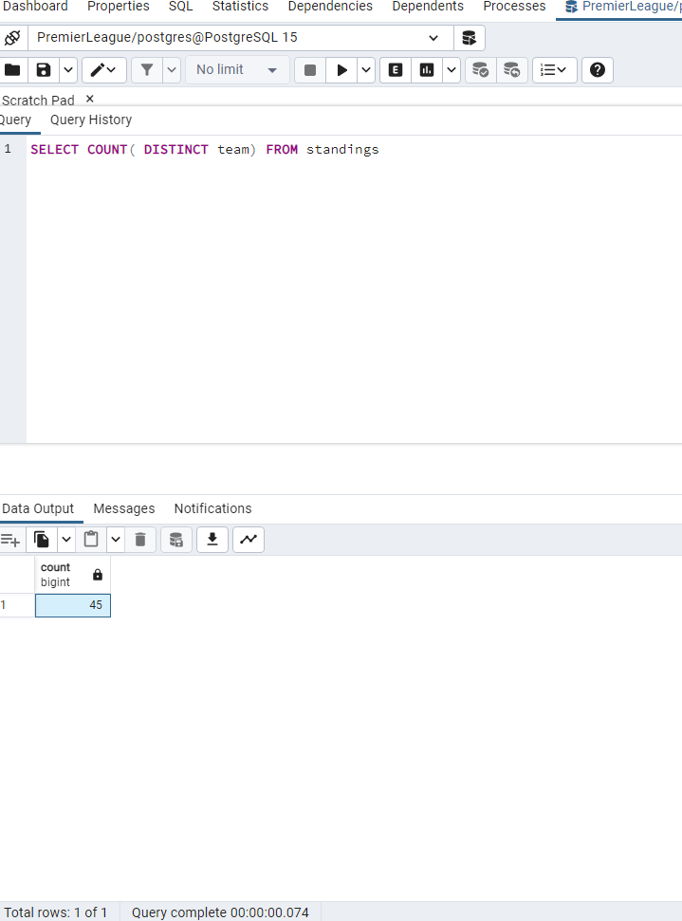
DATA ANALYSIS AND PROCESSING USING POSTGRESQL
First, I did an SQL count function on the 'Team' column, which contains all the teams from 2000 to the present day, to get the number of teams that competed in the premier league during that period.
So the number of teams that have competed in the Premier League since 2000 is 45.

Slide 5
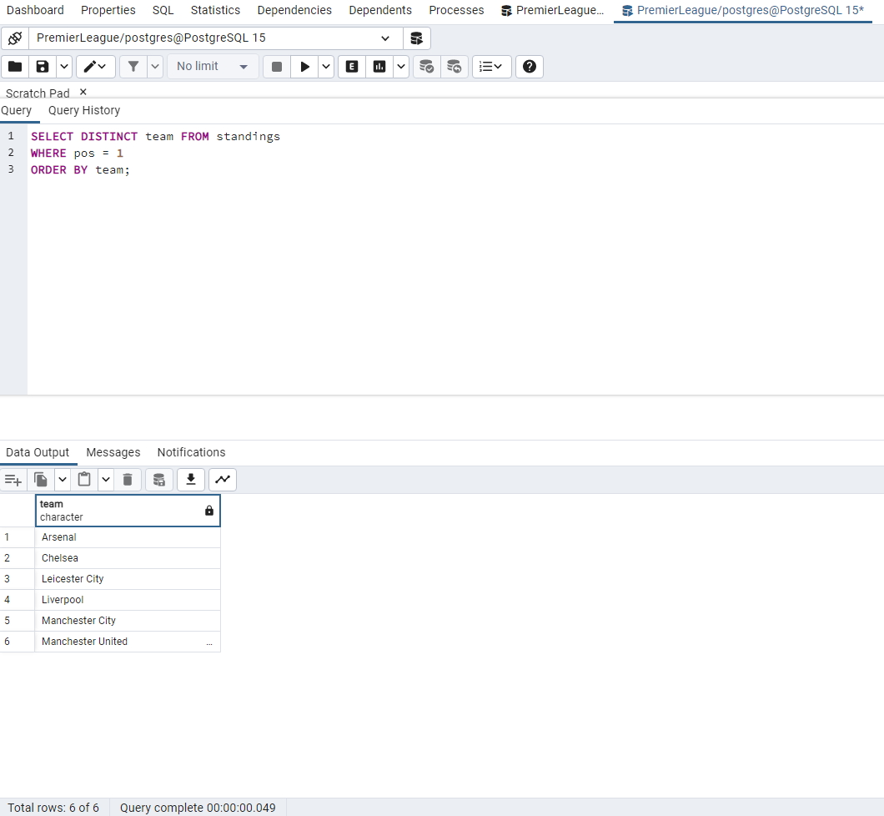
After the following SQL query in the "Premier League" database, I get the information that from 2000 to 2023 there were 6 different premier league champions.
As we can see, the champions were: Arsenal, Chelsea, Leicester City, Liverpool, Manchester City, and Manchester United.
So out of 45 teams who competed only 6 teams were able to win the premier league.

Slide 6
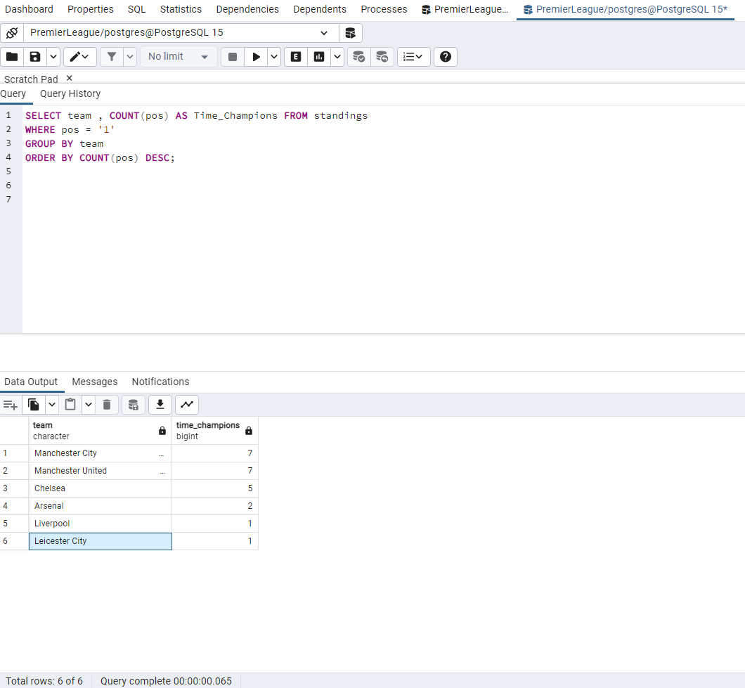
The next step is to see how many times a team has won the premier league. It's a little more complicated query, and we have to use aggregate functions, as well as 'group by statement'. I had to do this considering that in the previous query we only received the number of champions, but not how many times they were champions of the premier league, each of them individually.
As we can see, the 2 most successful teams from 2000 to today, as far as the premier league is concerned, are Manchester United and Manchester City with 7 championship titles each. They are followed by Chelsea with 5, Arsenal with two titles, and Liverpool and Leicester with one championship each.

Slide 7
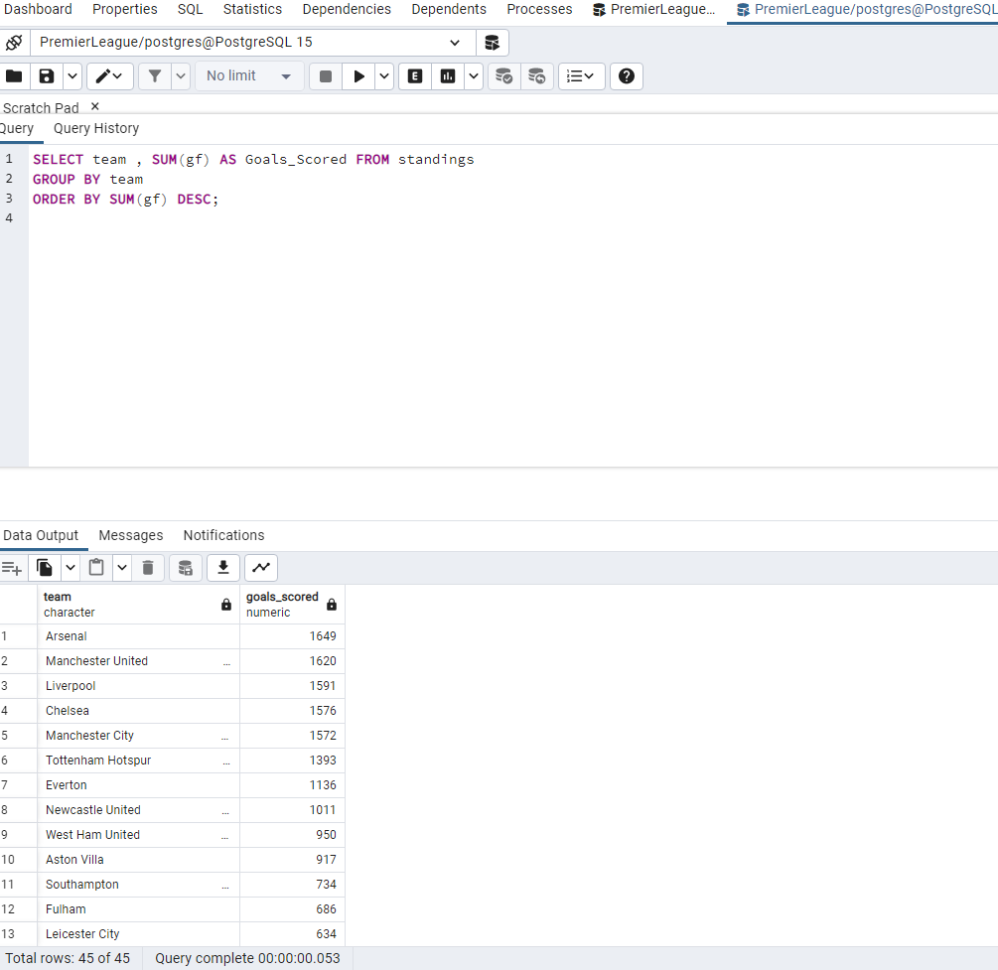
It is interesting that both the most successful teams come from the same city – Manchester.
To complete the picture of the premier league in the 21st century, in the following query I will find out which team scored the most goals in the premier league, ie which team was the most successful in attack.
From the question about scored goals, we come to the fact that the most successful attacking team in the Premier League in the last 23 years is Arsenal with 1649 scored goals.
Arsenal is followed by Manchester United, Liverpool, Chelsea and Manchester City, with a not very big difference in goals scored between them.

Slide 8
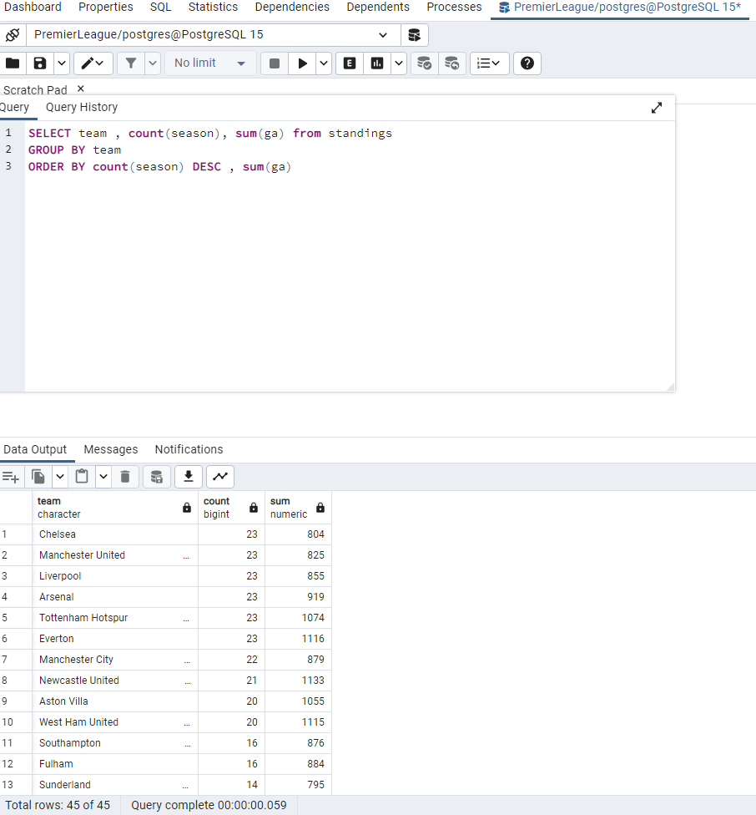
The next thing that we are interested in, is which team has conceded the fewest goals, that is, which team has the best defense in the Premier League in the past 23 years.
It is not as easy to query for goals conceeded as for the goals scored.
Given that certain teams have appeared in every season since 2000, and some teams have been relegated, and do not have that continuity, in the next query we had to first count the seasons each team played in, and then add up the goals conceded, and group them by teams.

Slide 9
We got the data that the best defense from 2000 to today is Chelsea with only 804 goals conceded in 23 seasons.
Chelsea is followed by Manchester United, Liverpool and Arsenal with a small margin, as well as Manchester City, which has played one season less than the previous 4 teams.
After analyzing the goals scored and conceded, I came to the conclusion that the team with the best attack, and also with the best defense of the past 23 years, are not the most successful teams in the Premier League.
This is it for SQL , now we will get more stats, and visualize data using Tableau.

Slide 10
Tableau visualization and analysis
Tableau is a great tool which can help us visualize our data, so the client can better understand what we’ve done.
I will visualize some data & stats, which I didn’t query during my SQL part of this project.
First thing that I will do, is that I sort the teams by their points average throughout their premier league span since the year of 2000.
Second interesting stat that I will analyze is which team played the least seasons in the premier league from 2000 until today.
The third and the final graph that I will create , will be about wins, to see which team has the most wins in the period that I am analyzing.

Slide 11
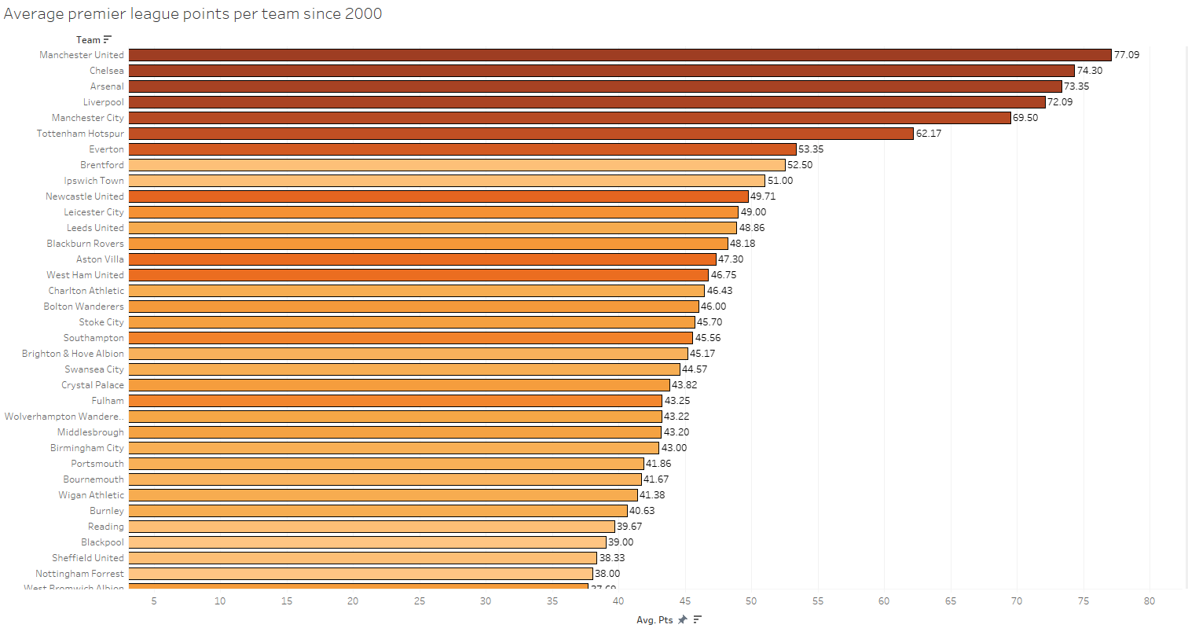
The best team by points average as we can see in this graph, is Manchester United with 77.09 average points per season.
Second is Chelsea with 74.30 , followed by Arsenal 73.35. We see most of the teams in this graph, as I don’t own paid version of Tablau , I cannot export charts as I would like to.

Slide 12
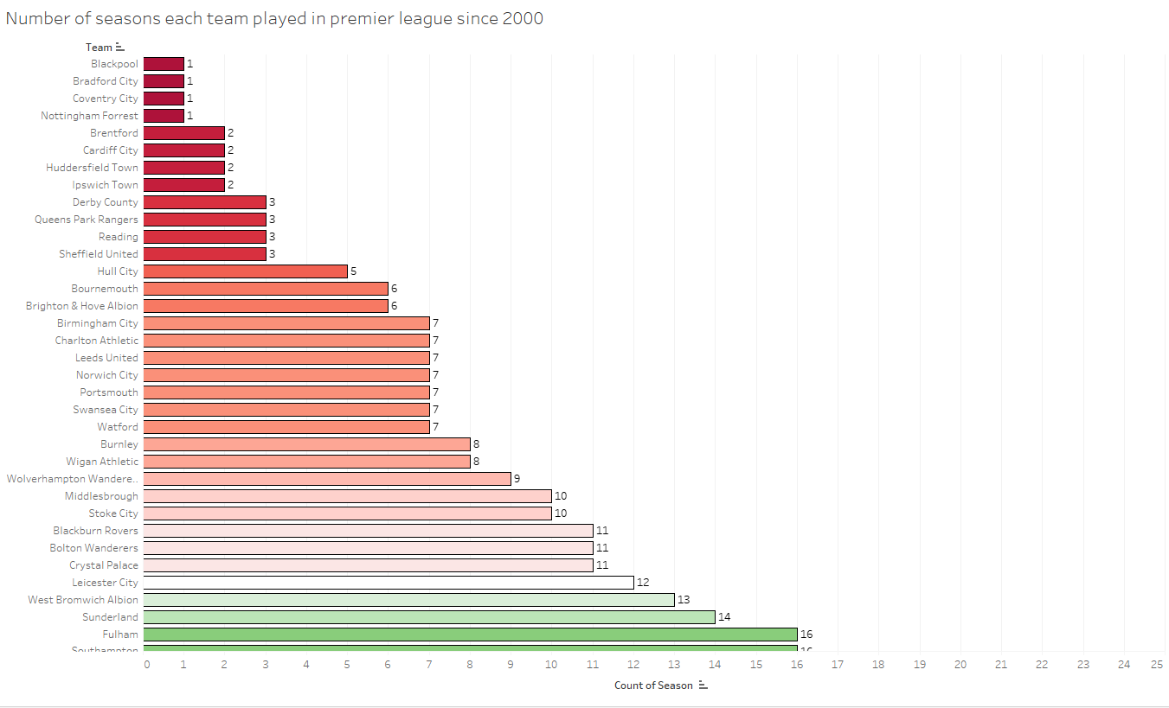
With this interesting stats we see how many seasons each team played in premier league. With this graph we want to highlight teams which played the least seasons in the 21st century, in the premier league. So as we can see, Blackpool, Bradford City and Coventry each played only 1 season in the premier league in 21st century.

Slide 13
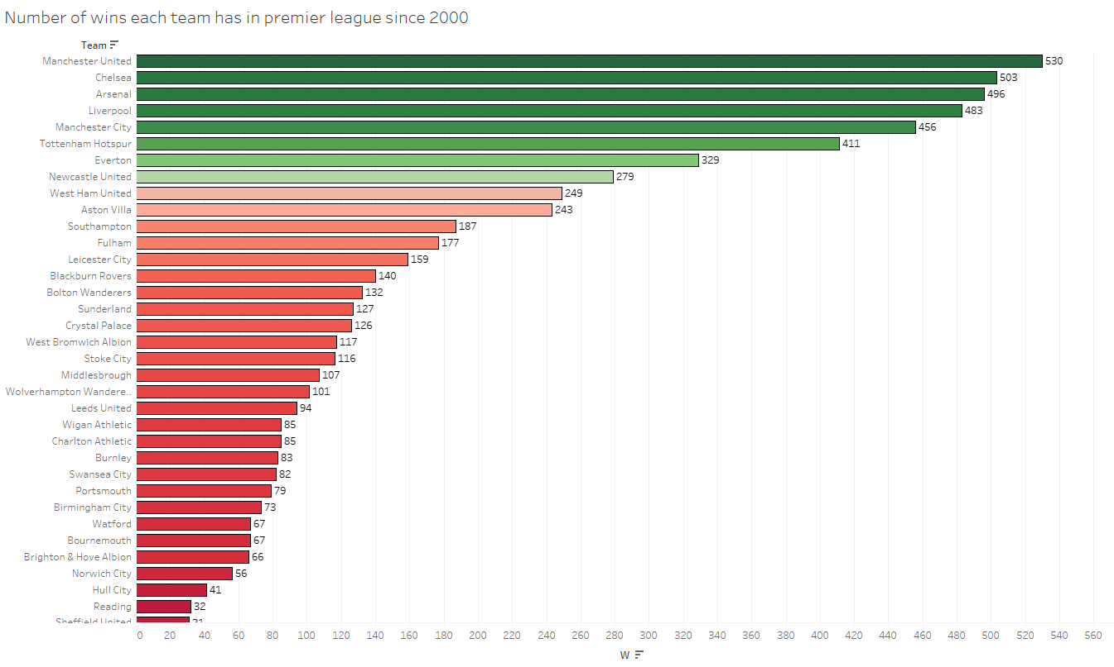
As we can see with our final graph, Manchester United has the most wins in the premier league history, with 530.
At the second place comes Chelsea with 503, followed by third placed Arsenal, which has 496 wins.

Slide 14
WHAT DID WE FIND OUT?
Manchester United and Manchester City are the two most succesful sides in the premier league since 2000 concerning the titles. They have both won 7 premier league trophies.
Manchester United tops the list in points average and wins. They are 2nd best attacking team of the century, and 2nd best defensive team of the century. They have played in each sesason since 2000 in the premier league.
Manchester City doesn’t top any of the lists, but they still managed to win 7 premier league trophies, which is interesting. They have 5th best attack , and 7th best defense. They come 5th with the most wins in the premier league since 2000.
Chelsea has won 3 premier league titles, and also has the best defense of the premier league since 2000. They have the 4th best attack, and 2nd most wins in the premier league since the year of 2000.
Arsenal is 4th interesting team. They have won the premier league twice since 2000, and they have the best attack in that period with 1649 goals scored. Their win total is 496, which comes at 3rd place. They also had pretty impressive defense in the last 23 years , as they hold 4th place in the list of the best defensive teams in the 21st century premier league.
Liverpool has some good stats, but only 1 premier league title to their name since 2000. They have 3rd best attack , and 3rd best defense. They also have 4th most wins in the premier league since 2000 with 483.
These teams are considered premier league’s ‘Big Five’
Created by: Kemal Gogić

